Slide 1
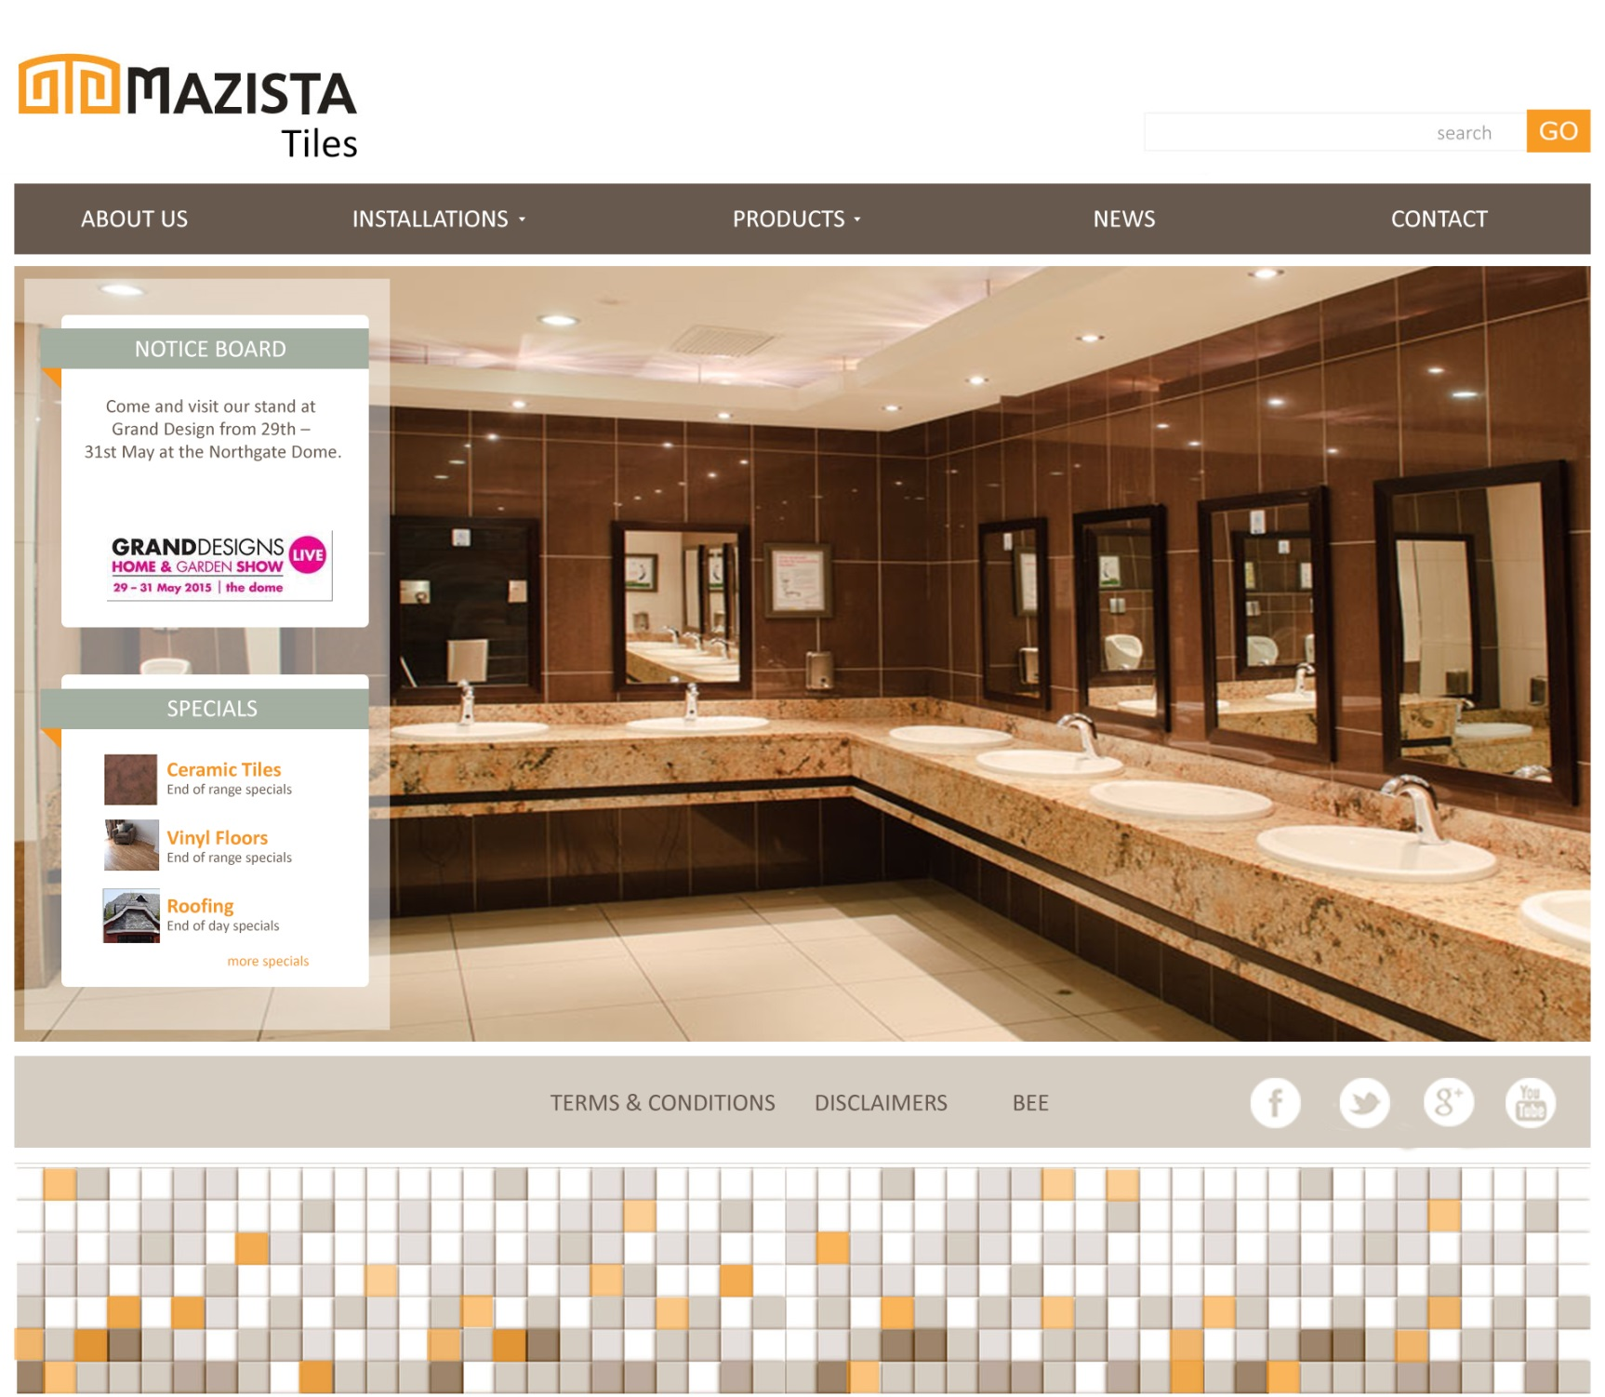
Home page

Slide 2
Fonts and colours

Slide 3
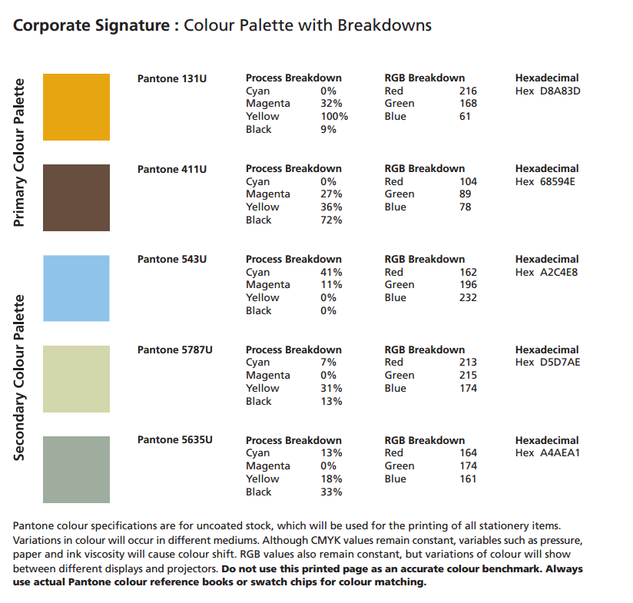

Slide 4
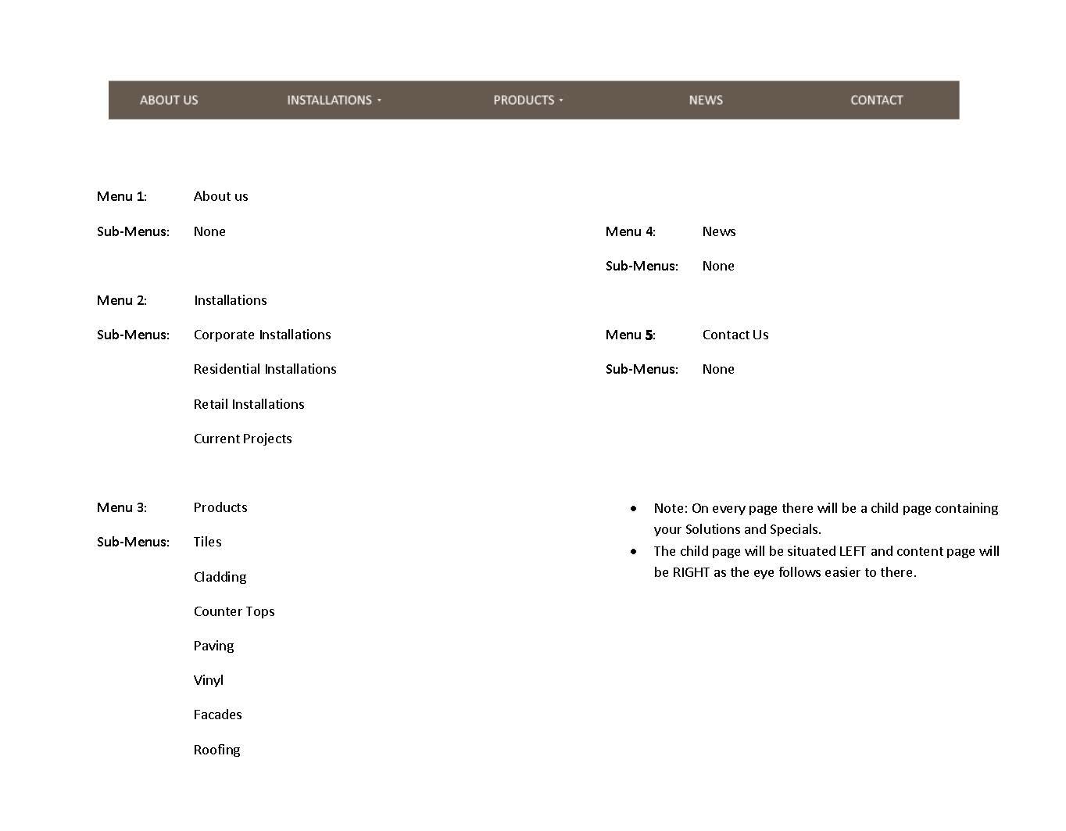
Menus and sub-menus

Slide 5
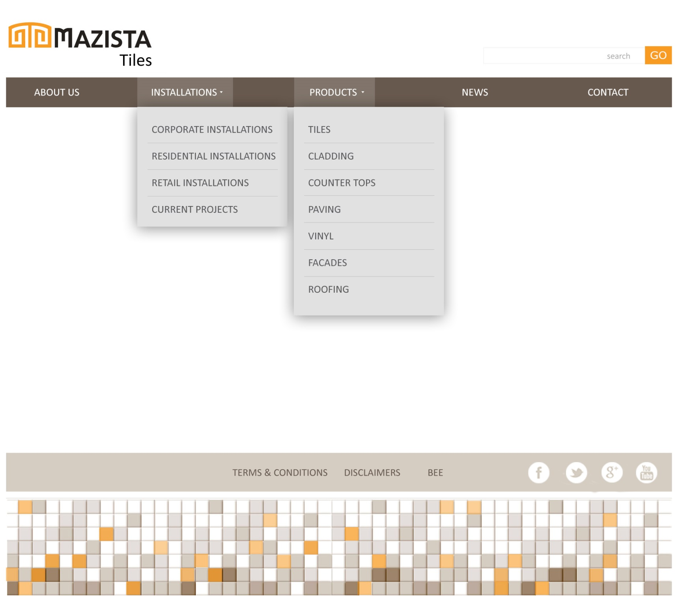
Dropdown menus

Slide 6
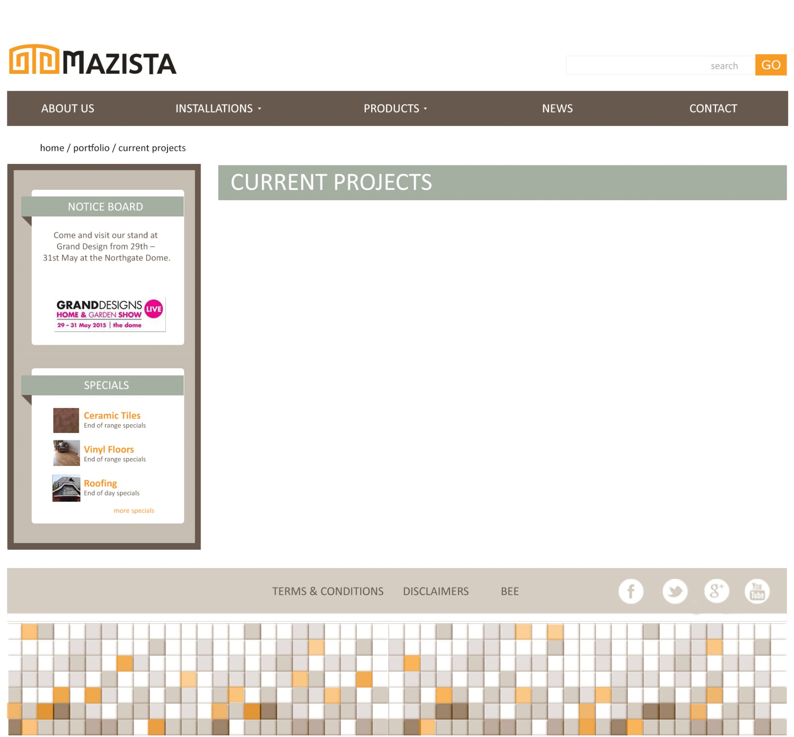
Child Page and Breadcrumbs
Each page will have a breadcrumb. This tells you exactly where on the website your are. This is important for simple navigation.
Every page will have this
Child Page on the left (eyes go here first) so
that there is always a selling
point on each page.
Every page will have the main page title displayed like this. We can change the colour…

Slide 7
About Us

Slide 8
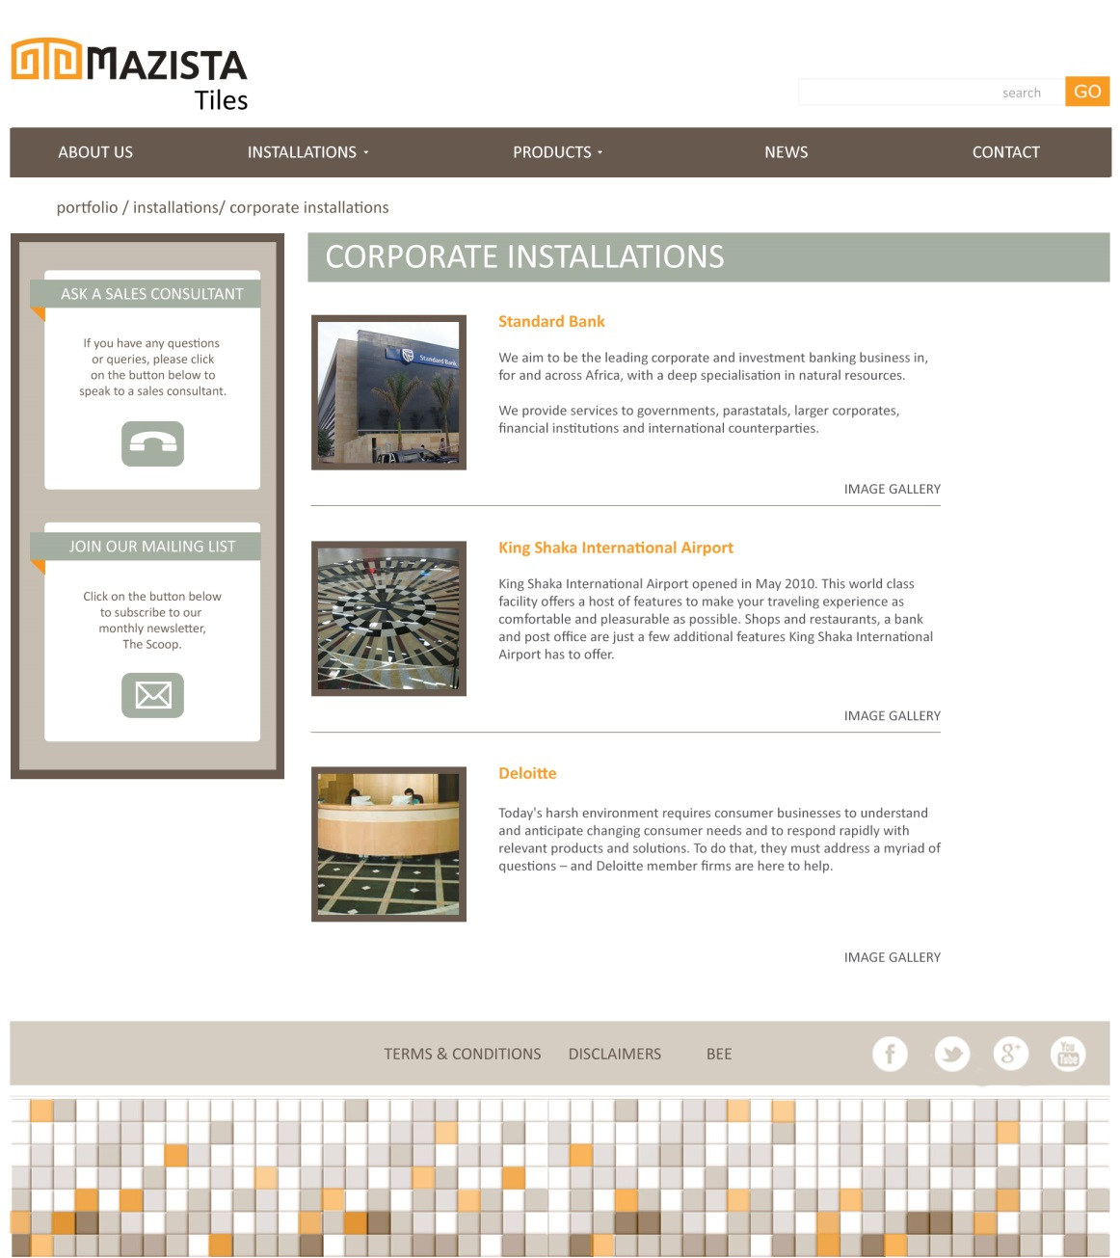
Portfolio > Corporate Installations
Here you will have:
A thumbnail of the project.
The project name
A short description of the project
The more projects the more pages
– we can add page 1,2,3 at the bottom

Slide 9
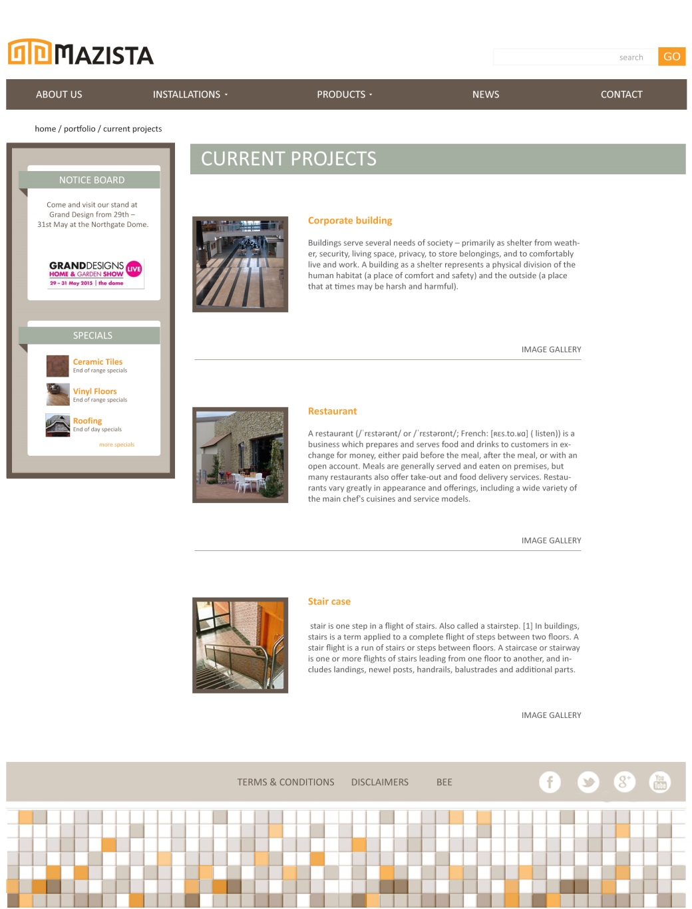
The image gallery of the project will open after selecting the project.
The gallery images can be clicked on to enlarge them
After clicking on the project, you will get the next page:

Slide 10
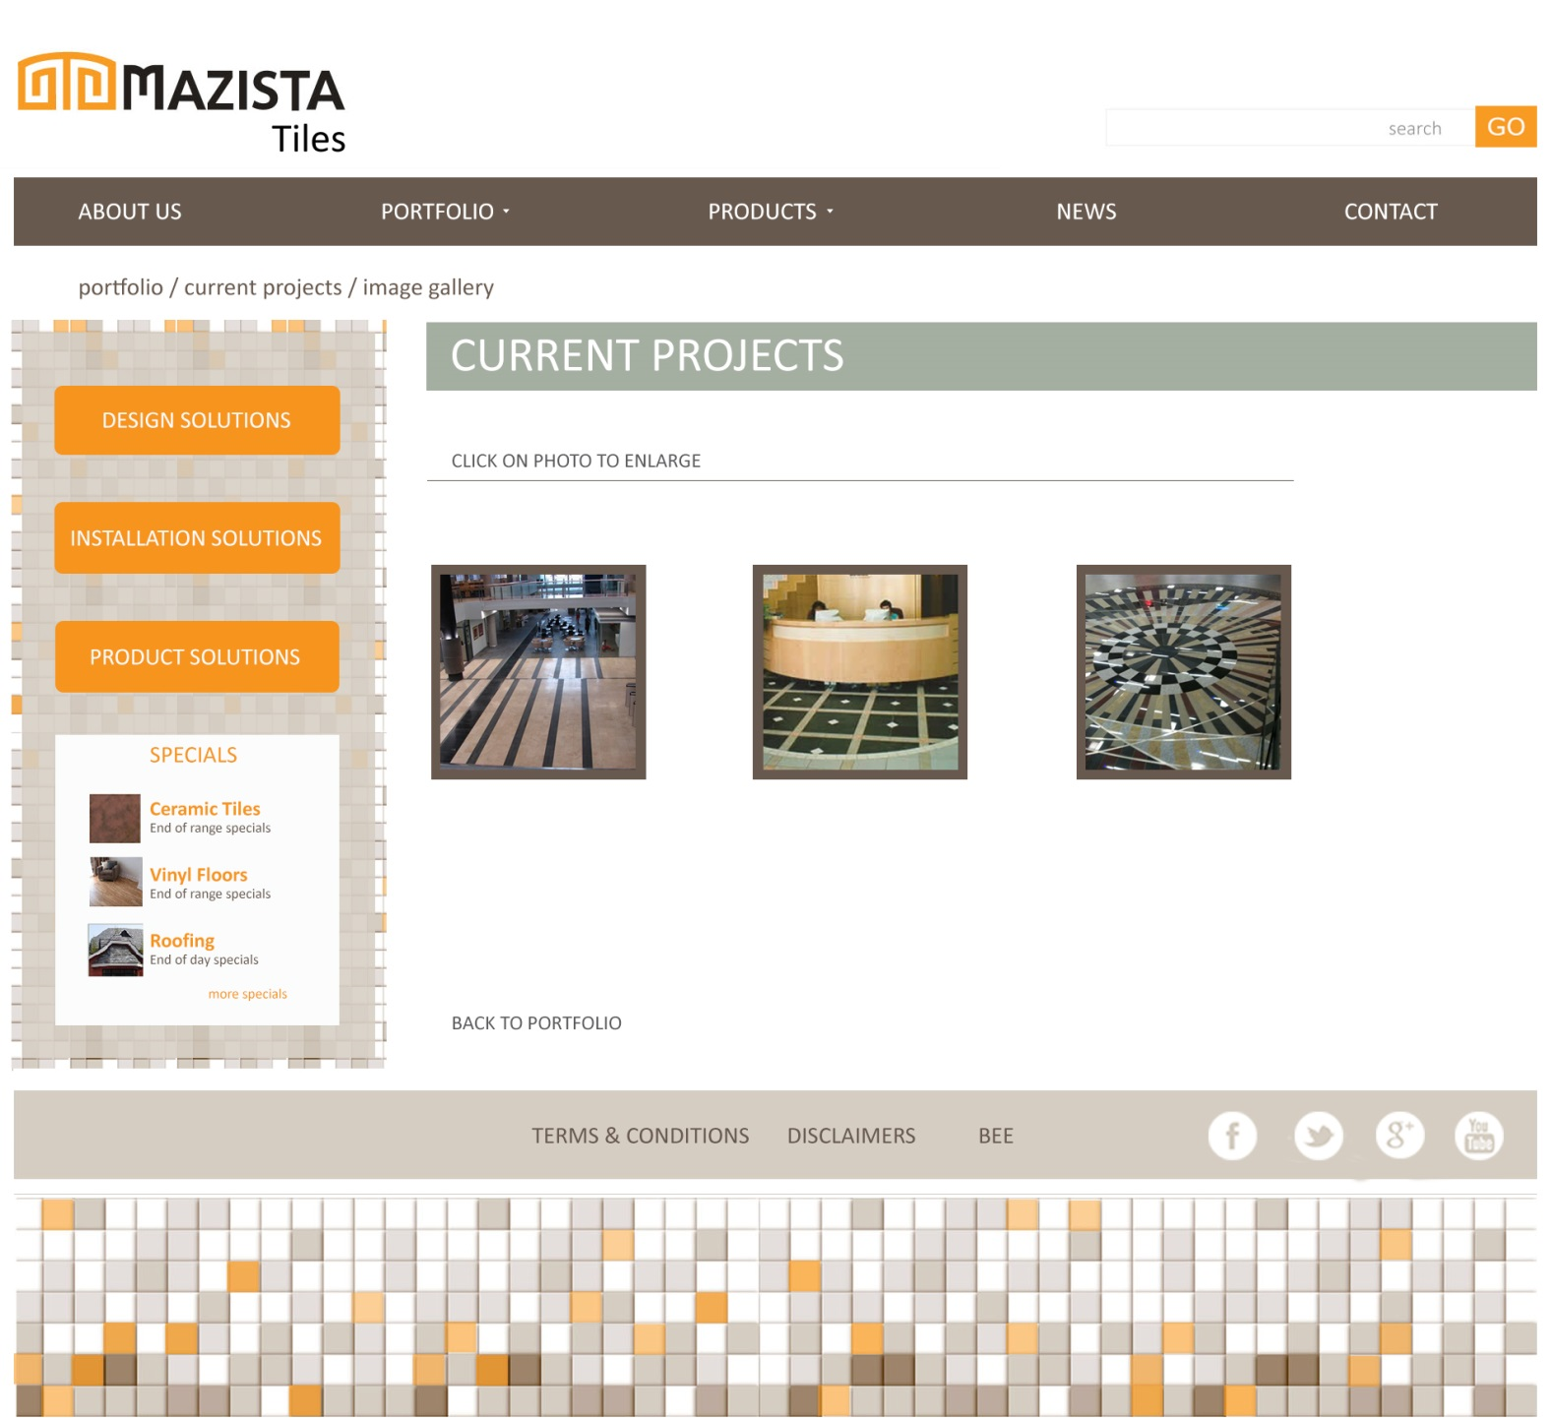
The image gallery of the project will open after selecting the project.
The gallery images can be clicked on to enlarge them

Slide 11
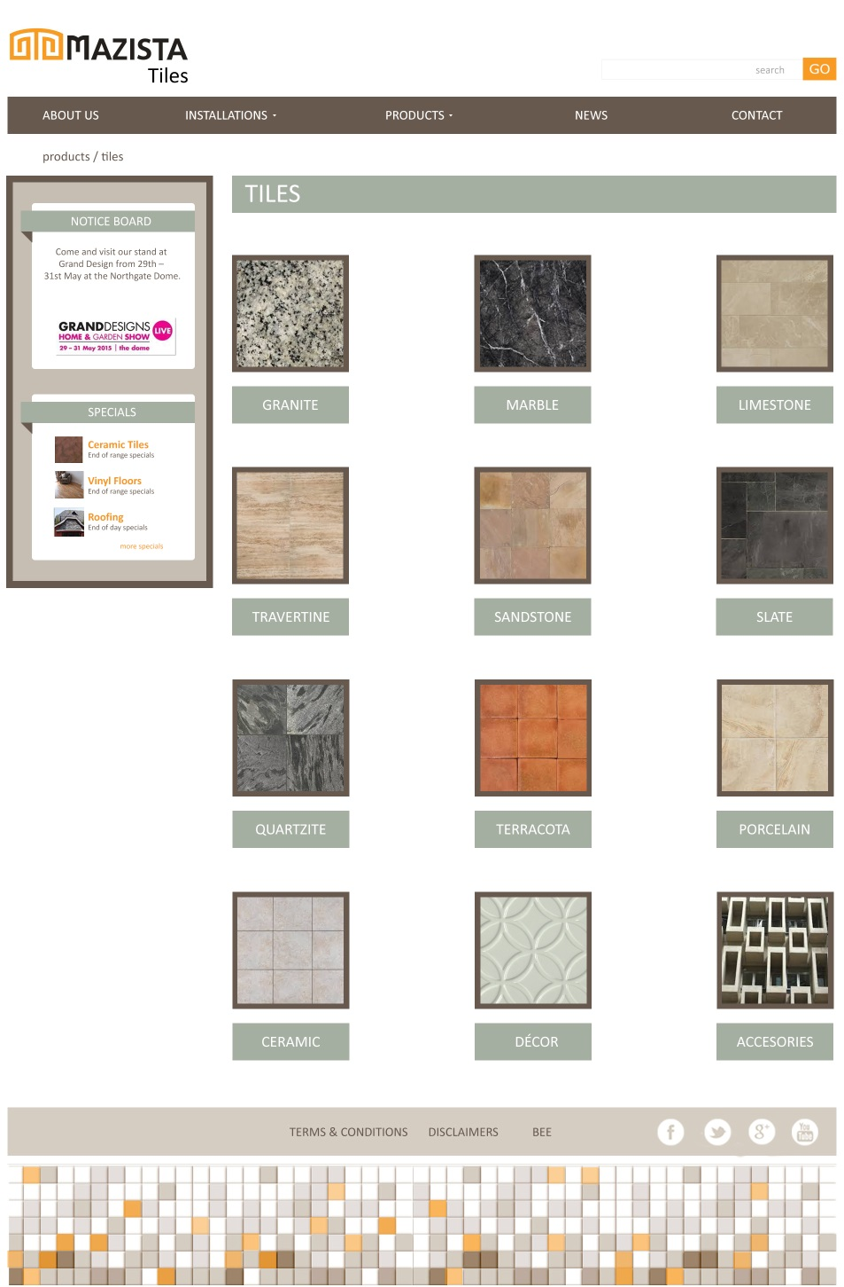
A dropdown menu of each product range can be selected.
After selecting TILES for instance – this is the fist page with tile categories.
From here you can select GRANITE for instance, taking you to the next page.

Slide 12
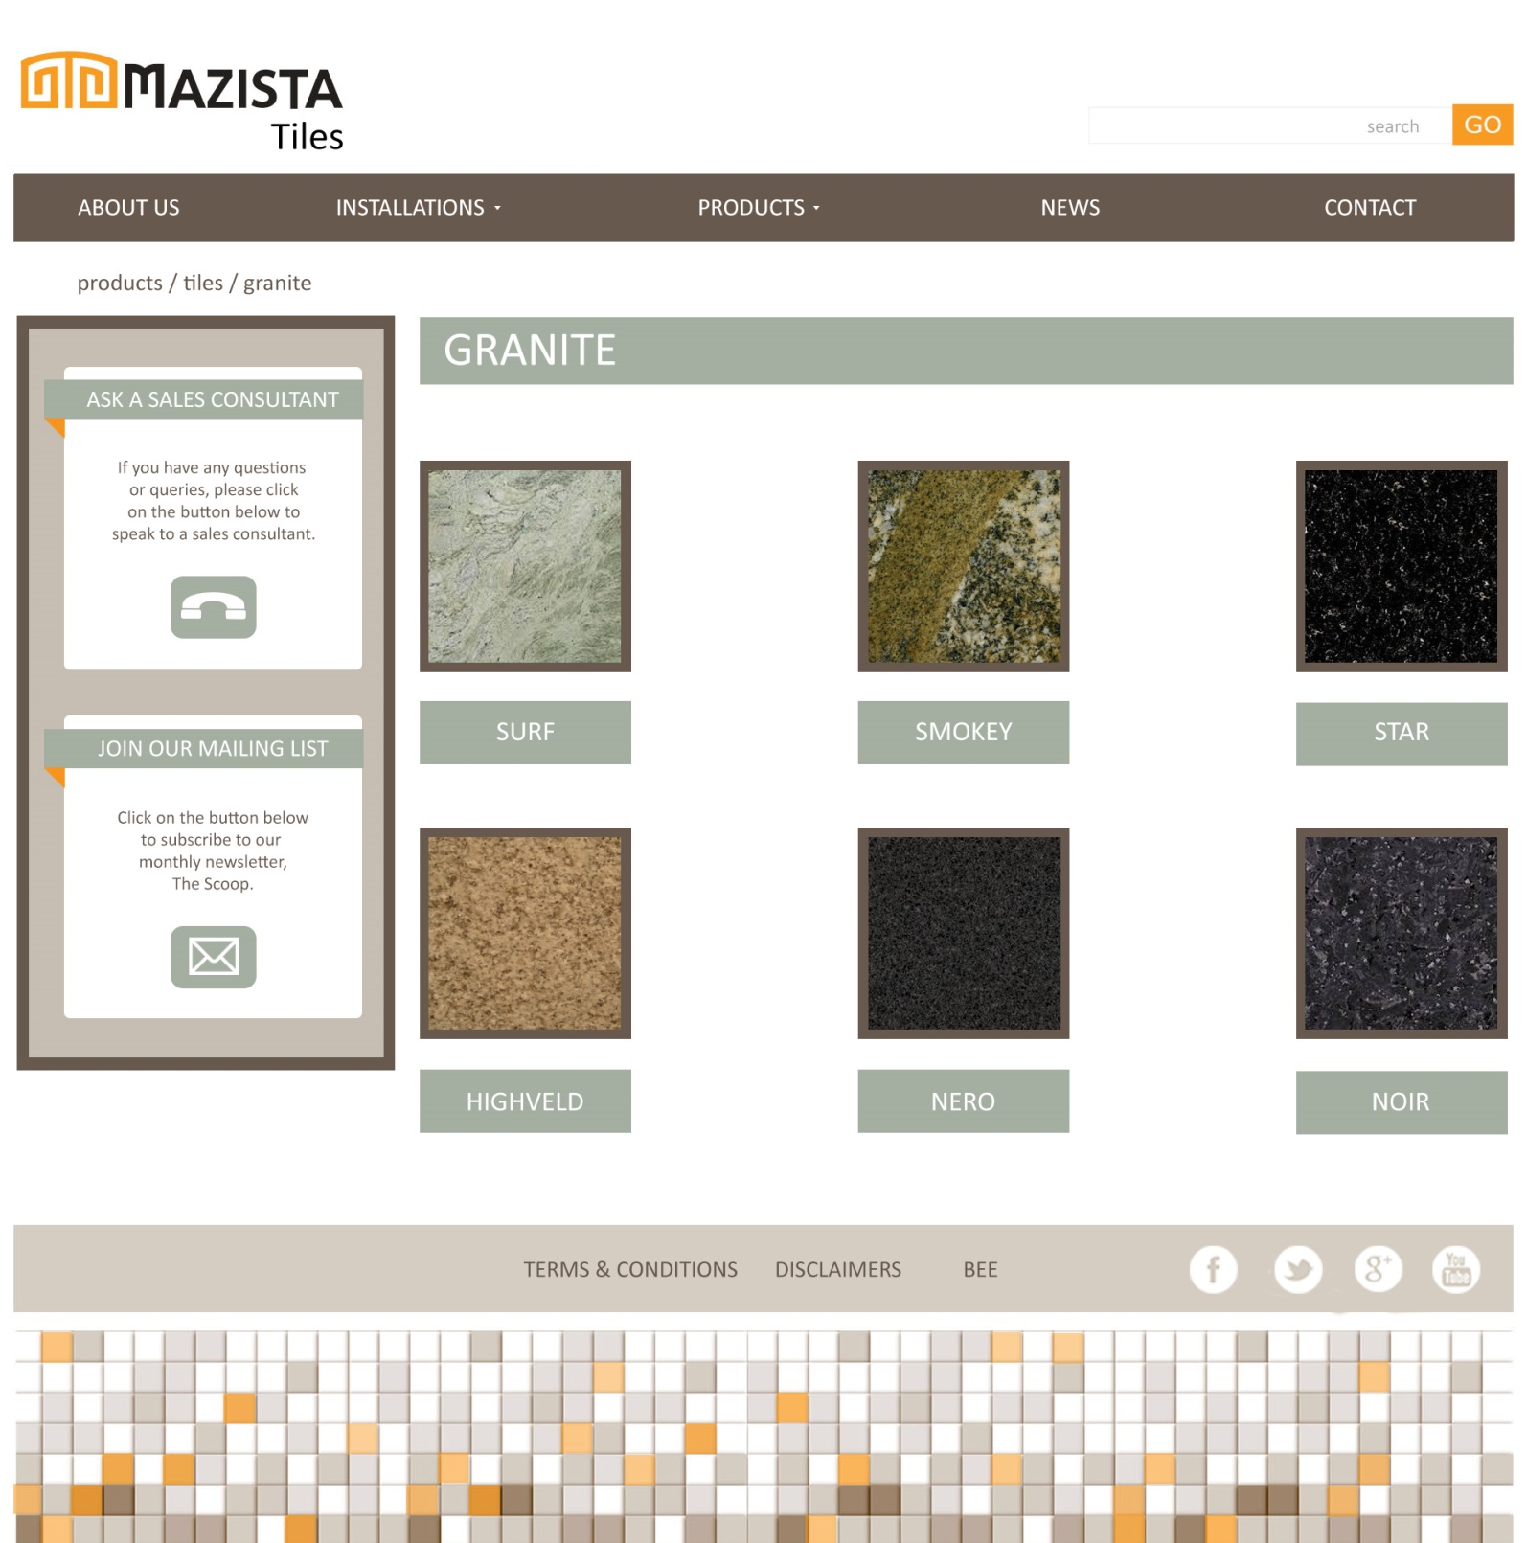
Granite then once again has different ranges of tiles. After clicking on a specific tile, it will take you to the tile information page. See next page

Slide 13
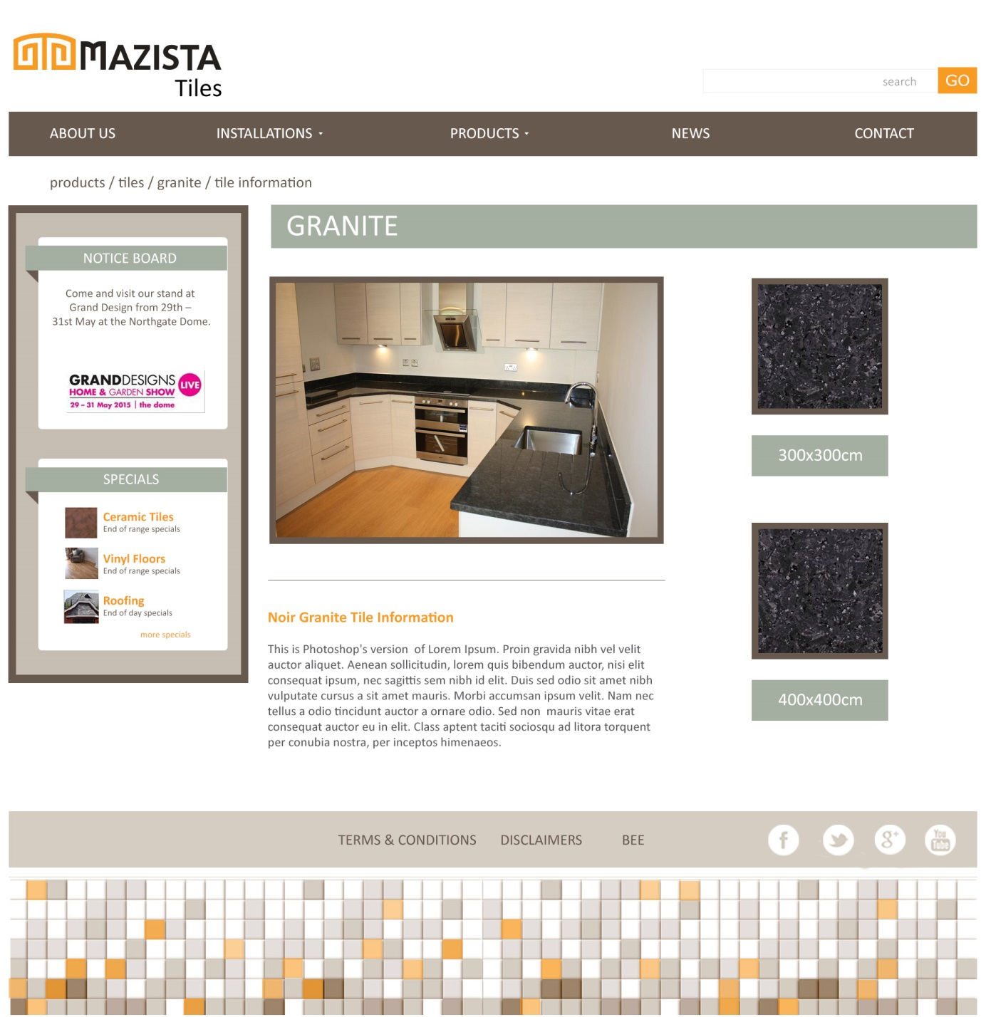
This is the tile information page.
It shows a picture of its
Application and then shows the
Standard sizes it comes in.

Slide 14
NEWS
We tried keeping this news page as close to the current blog.

Slide 15
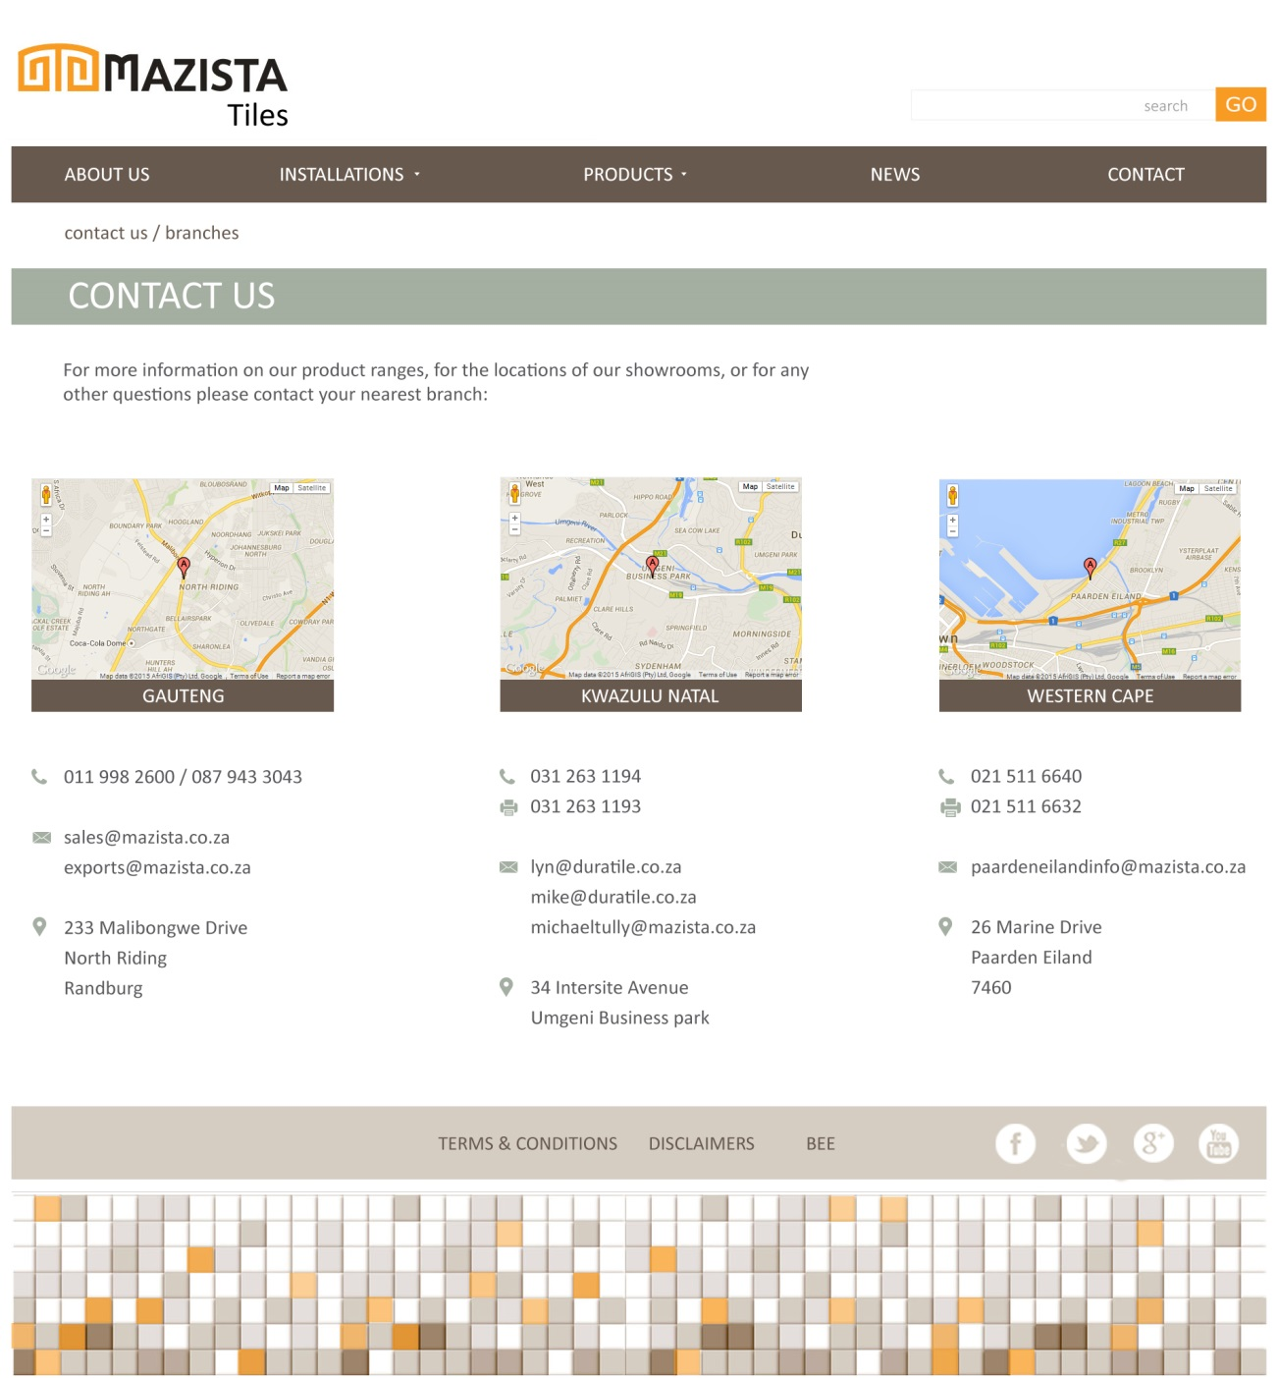
Contact Us
We want to embed google maps here, and keep the layout neat and simple

